Slide 1

Roll Call Attendance Tool
Simple Portfolio Presentation Designed
Fourth IST (Artificial Intelligence)
Date:26/8/22

Slide 2

Group Members
Mg Thwin Htoo Aung (4IST-2)
Mg Hein Thant Aung(4IST-21)
Mg Khaing Kyaw Lin(4IST-30)
Mg Yel Min Htike (4IST-49)
Mg Mabu Phong (4IST-40)
Mg Htoo Aung Lwin (4IST-64)

Slide 3
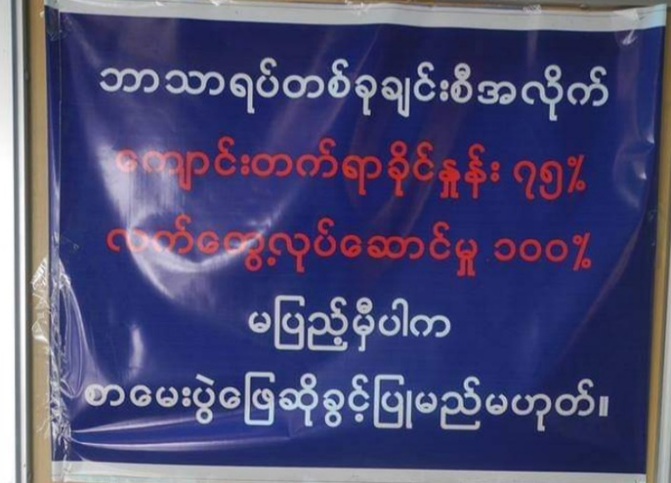
Attendance Requirement
A student must obtain a minimum of 75% attendance
in each subject individually.
If he got debarred, he will not be
eligible to sit for
end semester exam!
In 2013, 178 students got debarred in
University Of Tehnology (Yadanarpon Cyber City)

Slide 4
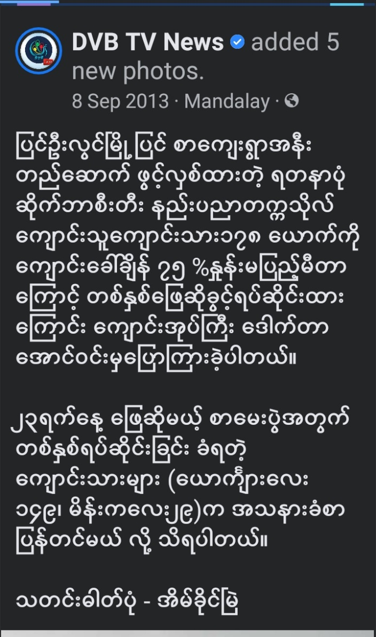
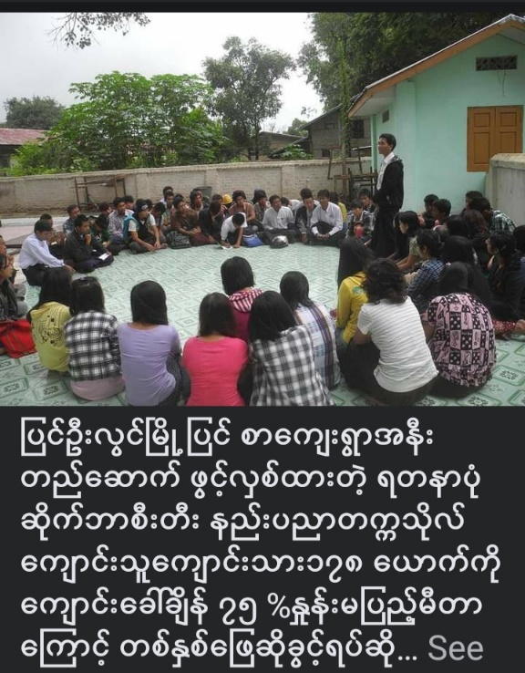


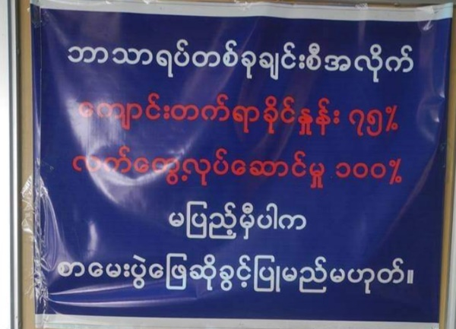
Debarment Of Student
In 2013, 178 students got debarred in UT-YCC

Slide 5

Applied Theory/Software
Prolog
Knowledge Base
모바일 이미지
Artificial Intelligence
Roll Call Attendance Tool

Slide 6
Project Objective
Debarment
Of
Student
1
Calculation
Of
Absence
2
To make it easy to compile the lists of subjects having attendance less than 75%.
[ For teachers ]
To be able to know Roll-Call Attendance and to calculate periods of absence.
[For Students]

Slide 7
Time Table for fourth Year IST (Second Semester)
Day/Time | 1 | 2 | 3 | 4 | 5 | 6
Monday | English | English | Image | Math | Math | Image
Tuesday | Math | Math | Image | Image | Networking | Networking
Wednesday | HSS | HSS | English | SE | UML | UML
Thursday | Networking | Networking | Networking | SE | HSS | HSS
Friday | UML | UML | SE | AI | AI | AI
Subject Name Code
Subject Name Code
English E-42011 Image ISCE-42054
Math ISCE-42014 SE IS-42061
AI ISCE-42071 UML IS-42117
Networking ISCE-42043 HSS HSS-42001

Slide 8
Total Lecture By Each Day [ May12 – August31 ]
Day | Total Counts
Monday | 16 Days
Tuesday | 16 Days
Wednesday | 16 Days
Thursday | 16 Days
Friday | 16 Days
We can calculate our attendance percentage by each individual absence day. For this purpose, our project
propose the prolog method- testDay({name_of_day},{total_count_of_absence})

Slide 9
Total Lecture By Each Subject [ May12 – August31 ]
Subject | Total Counts
English (E-42011) | 48
Mathematics (ISCE-42014) | 64
Artificial Intelligence (ISCE-42071) | 48
Networking (ISCE-42043) | 80
Image Processing (ISCE-42054) | 64
Software Engineering (IS-42061) | 48
UML (IS-42117) | 64
HSS (HSS-42001) | 64
We can calculate our attendance percentage by each individual subject name. For this purpose, our project
propose the prolog method- testSubject({name_of_subject},{total_count_of_absence})

Slide 10
Thank you
For Your Attention

